Slide 1
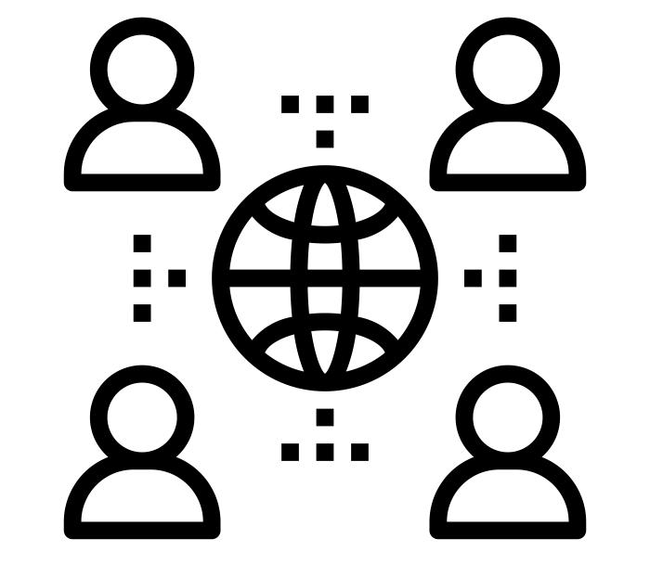
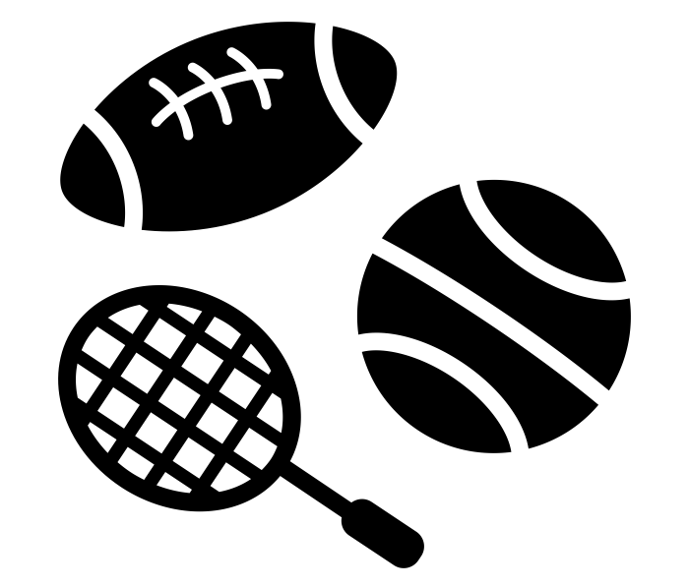
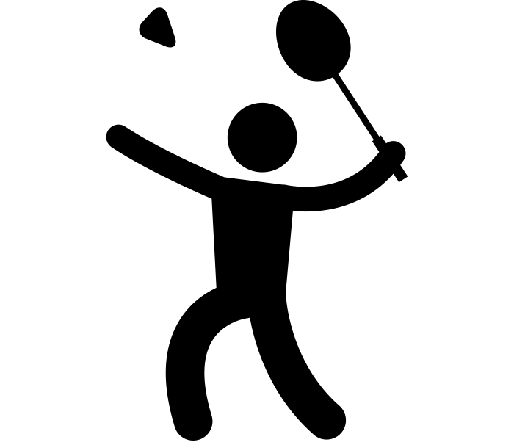
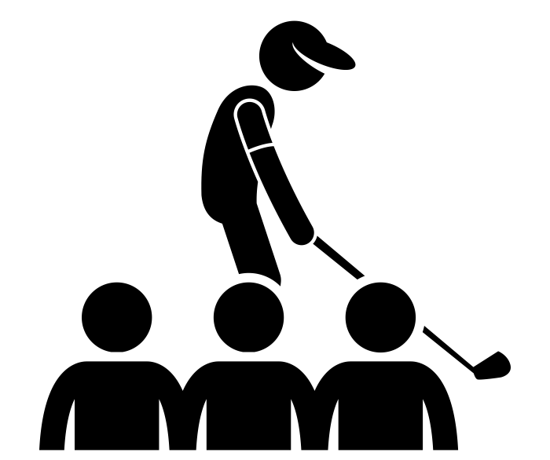
Commercilisation and media; positive and negative impacts of the commercialisation of physical activity and sport
Society
Individual sports
Performers
Sectators
Notes:
Sports by Minh Do from the Noun Project
Badminton by Gan Khoon Lay from Noun Project
Society by Sumit Saengthong from Noun Project
golfer and spectator by Gan Khoon Lay from the Noun Project

